Slide 1
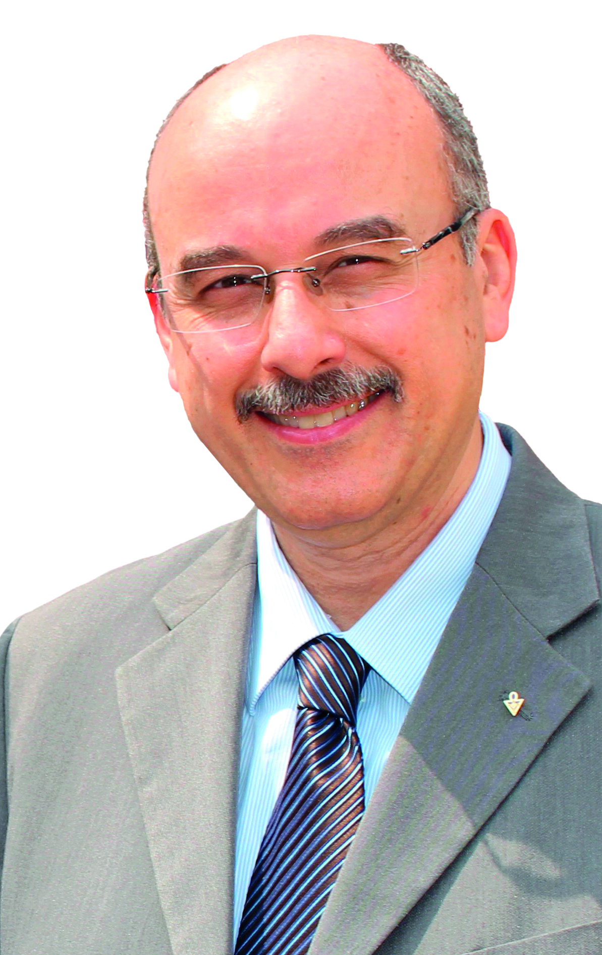

Imperator Claudio Mazzucco Conventions and Visits to Affiliated Bodies 2023

Slide 2
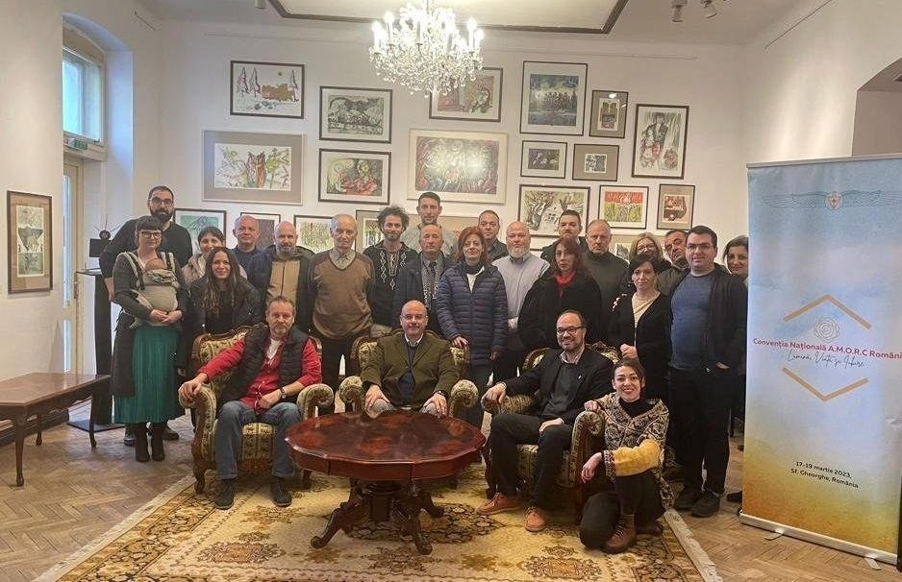
Romenia
March 2023

Slide 3
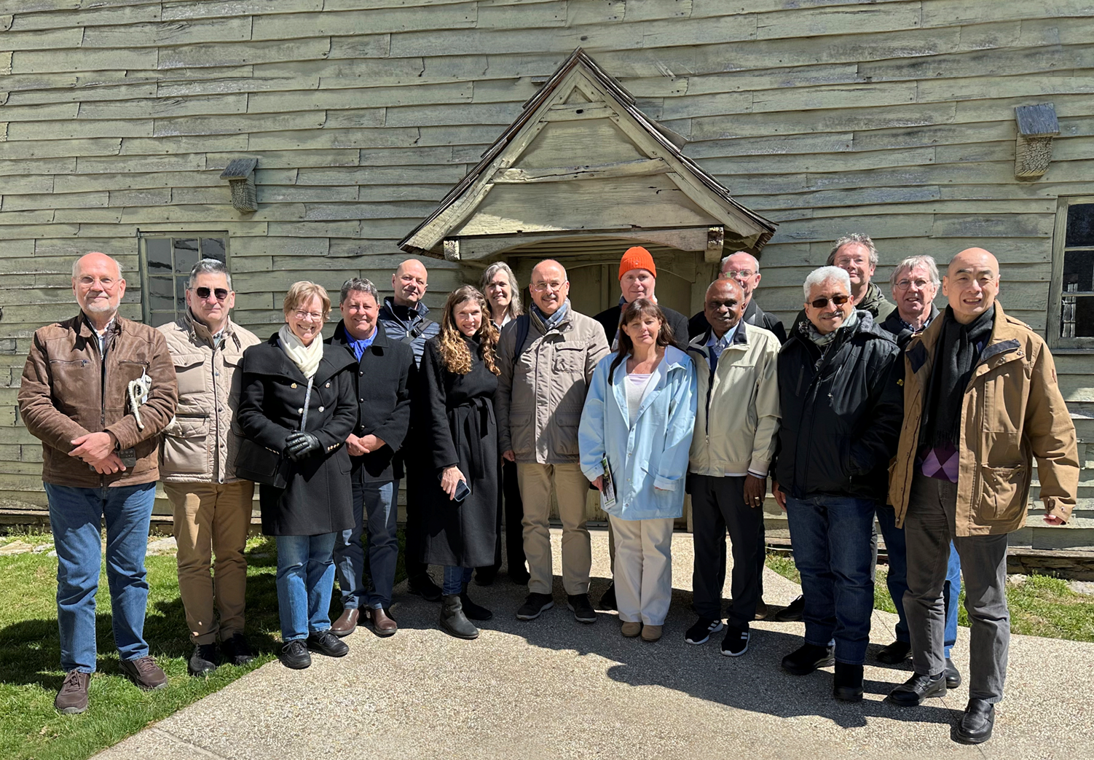
United States - Ephrata
Supreme Council Board Meeting
April 2023

Slide 4
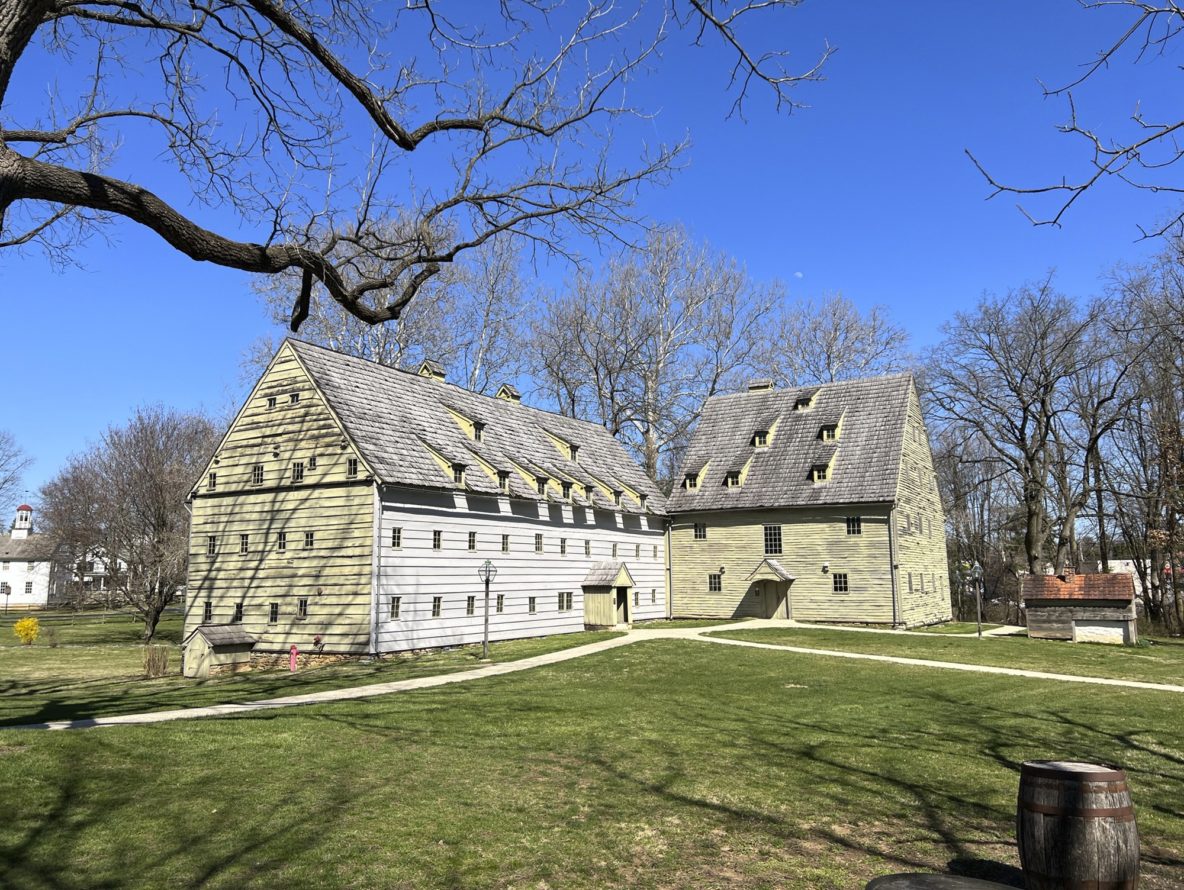
Ephrata United States
April 2023

Slide 5
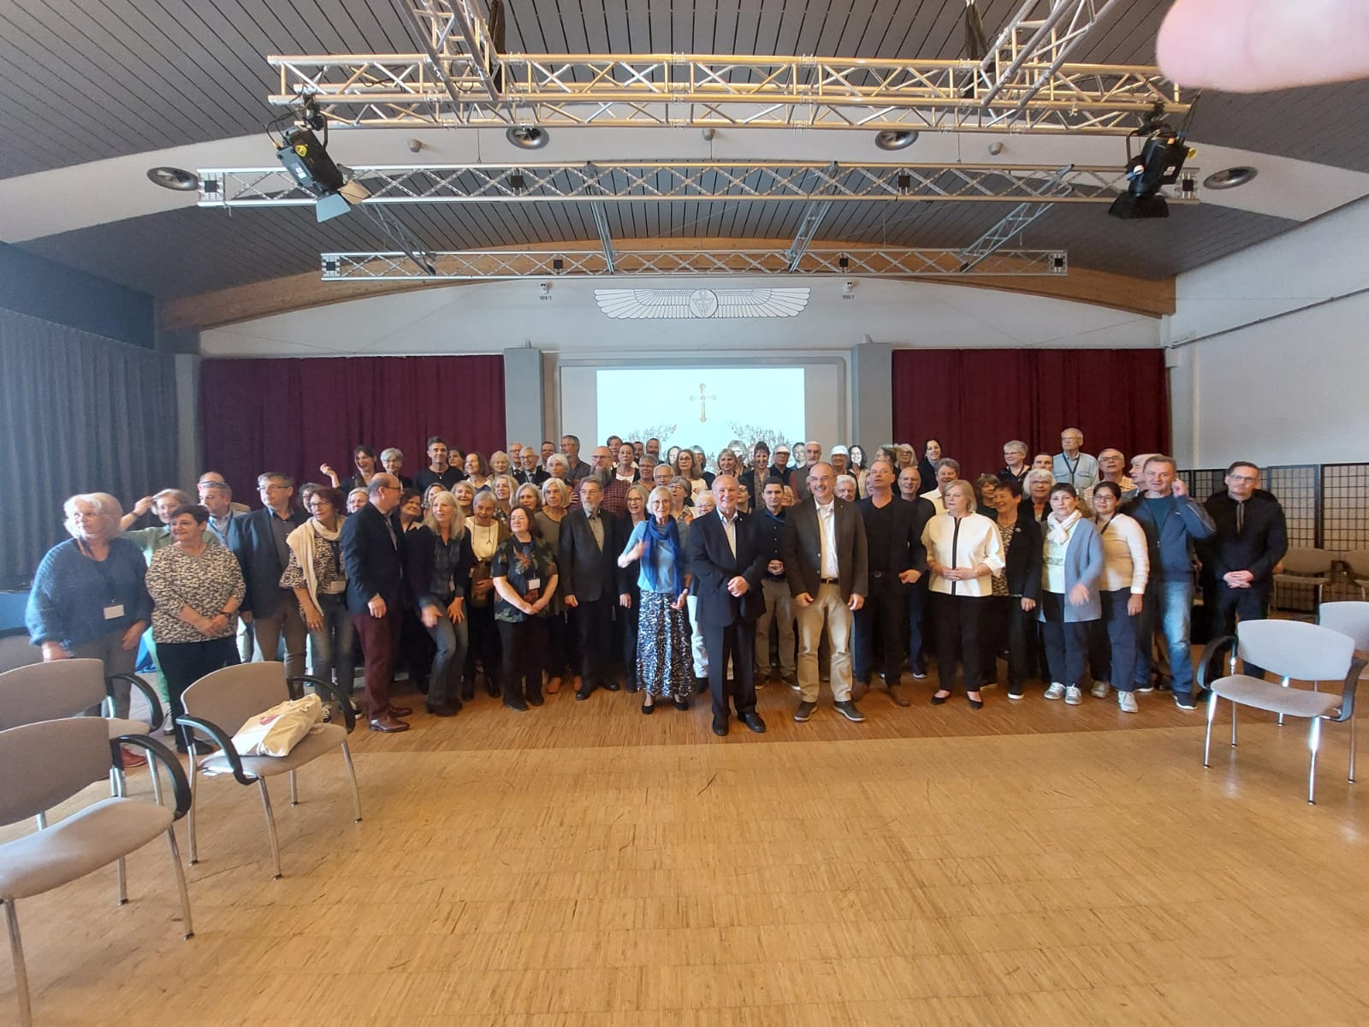
Germany
May 2023

Slide 6
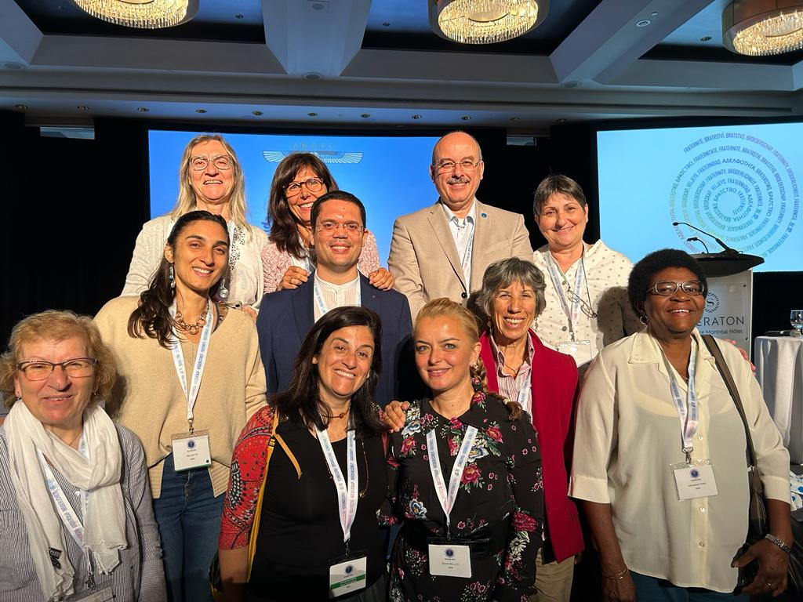
Montreal – World Convention
August 2023

Slide 7
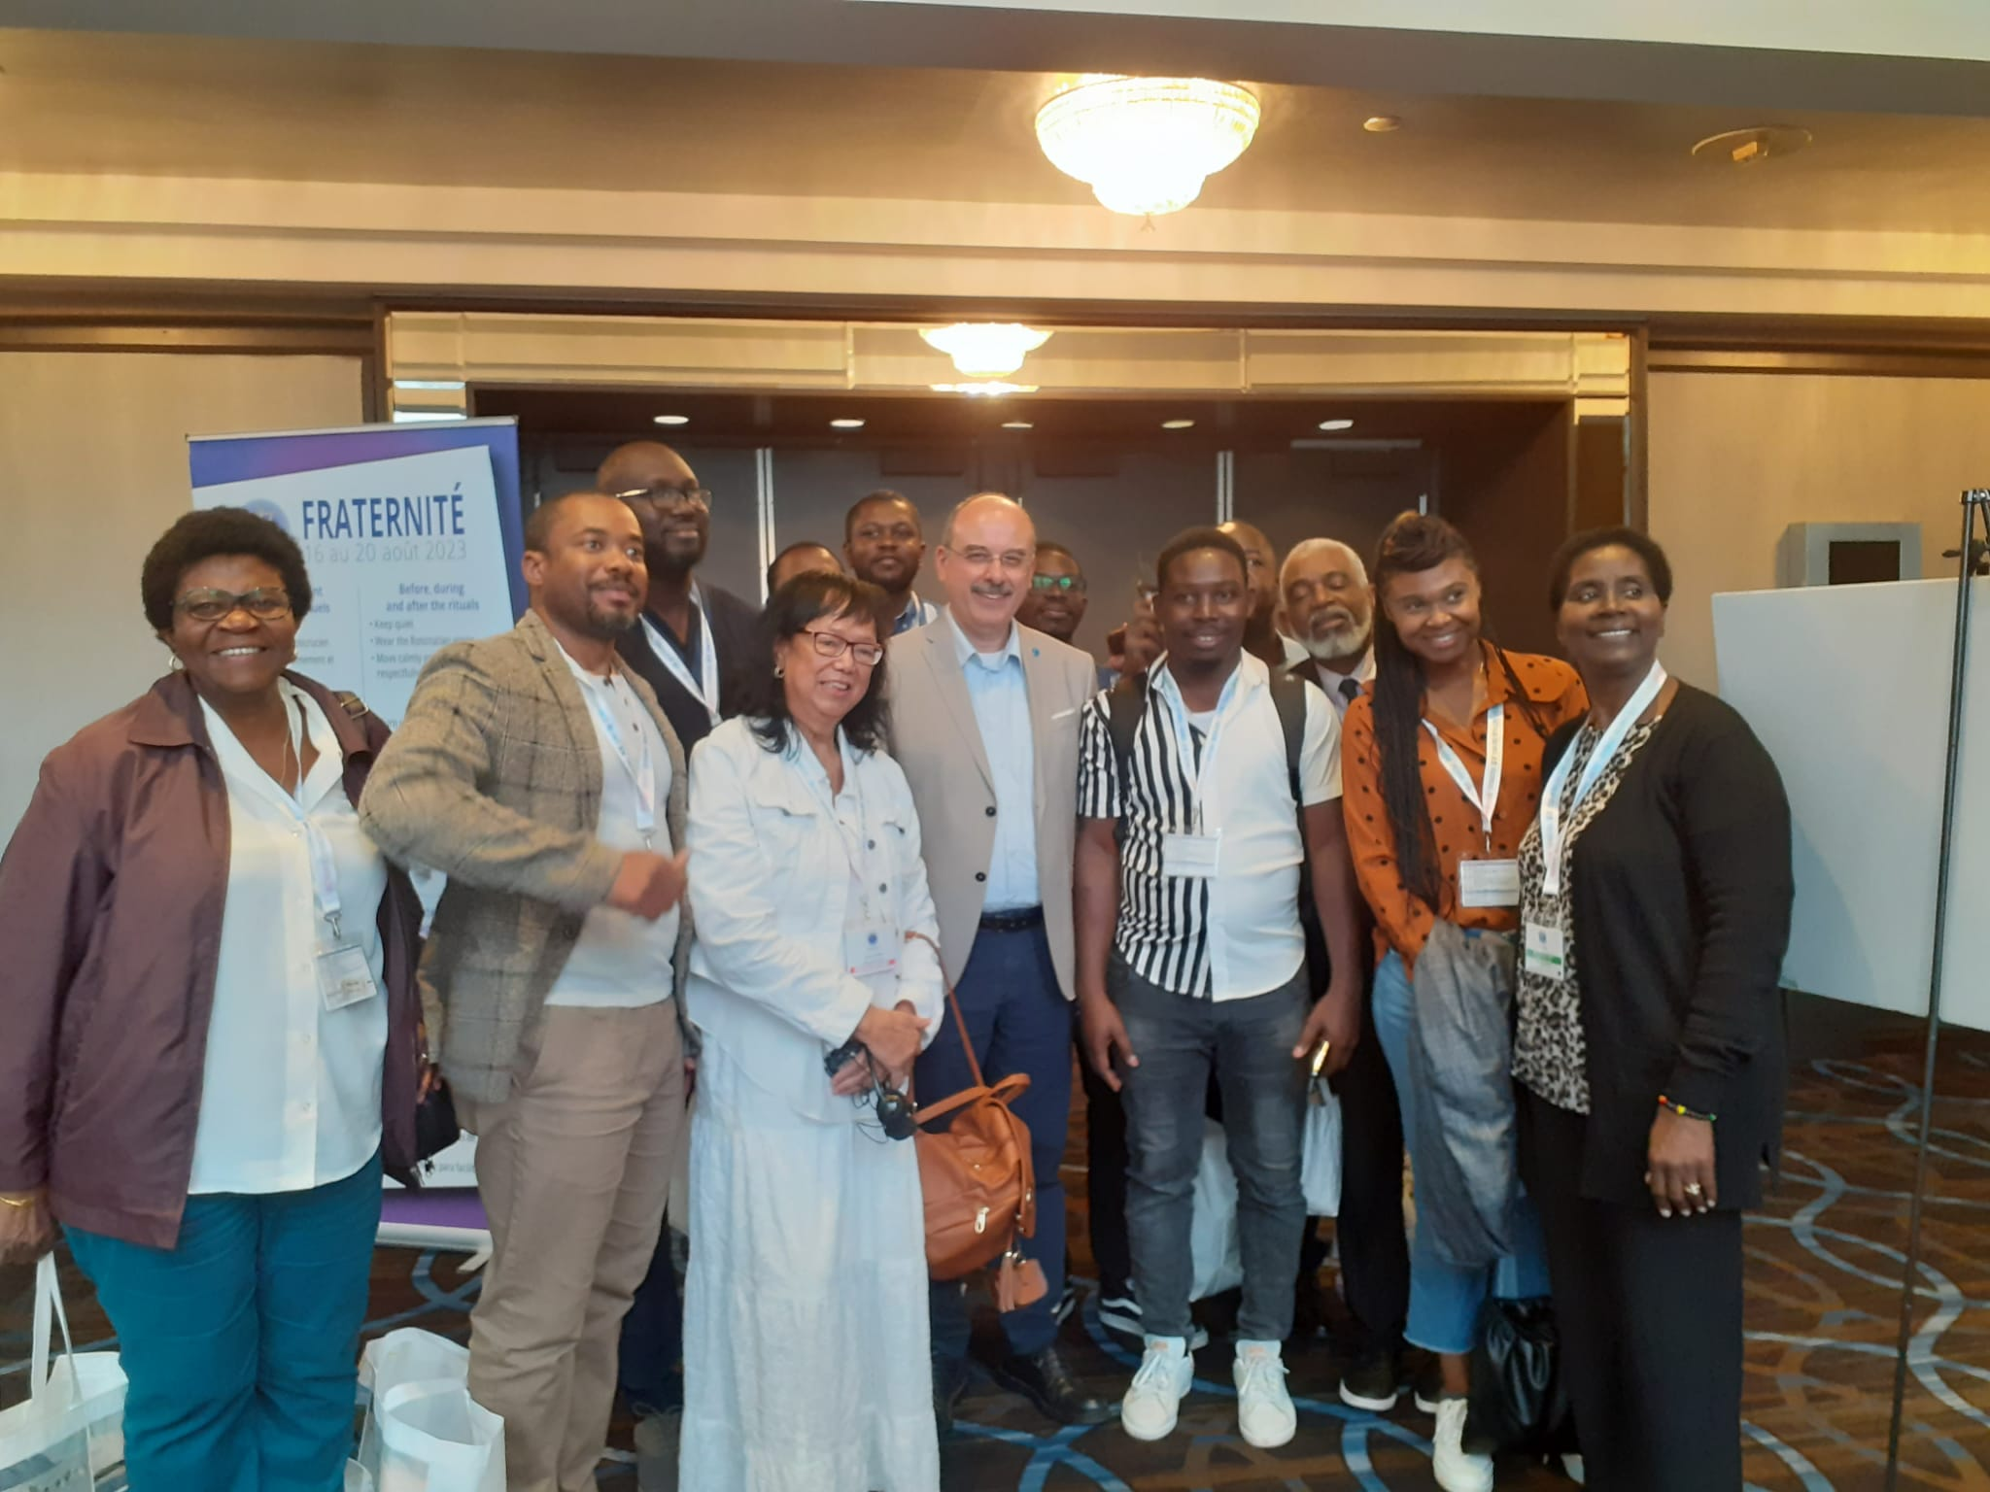
Montreal – World Convention
August 2023

Slide 8
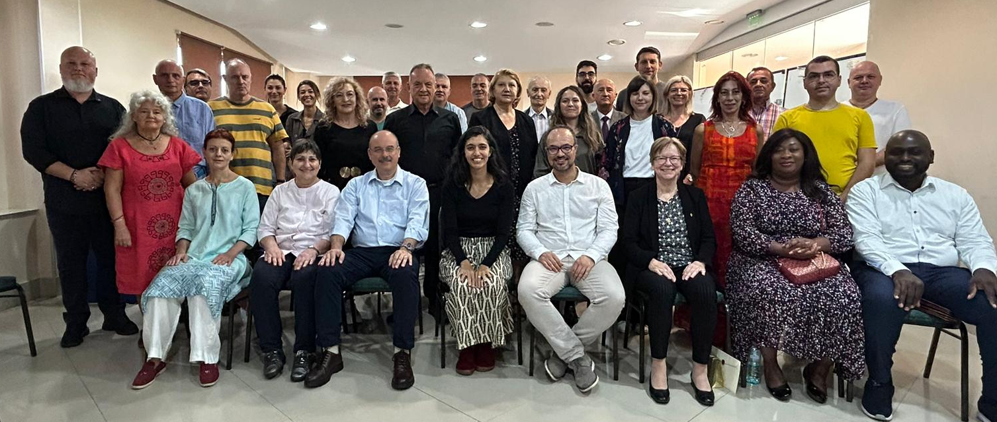
Romania
Installation of New Grand Master Frater Raul Passos
October 2023

Slide 9
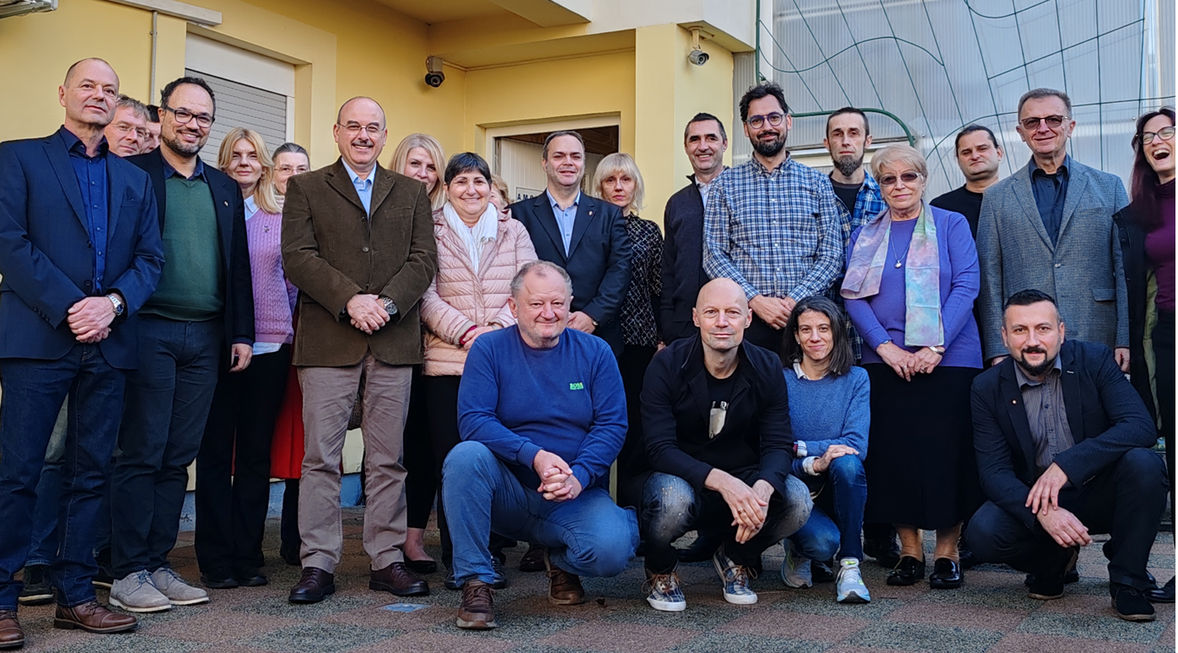
Zagreb
October 2023

Slide 10
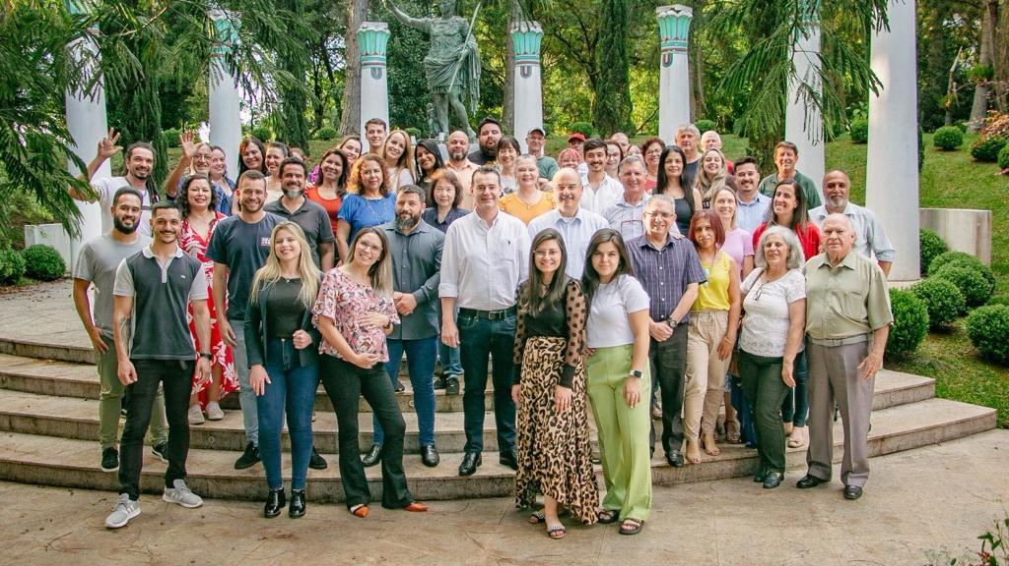
Brazil Installation of the new Grand Master Frater Heverton Guzzi November 2023

Slide 11
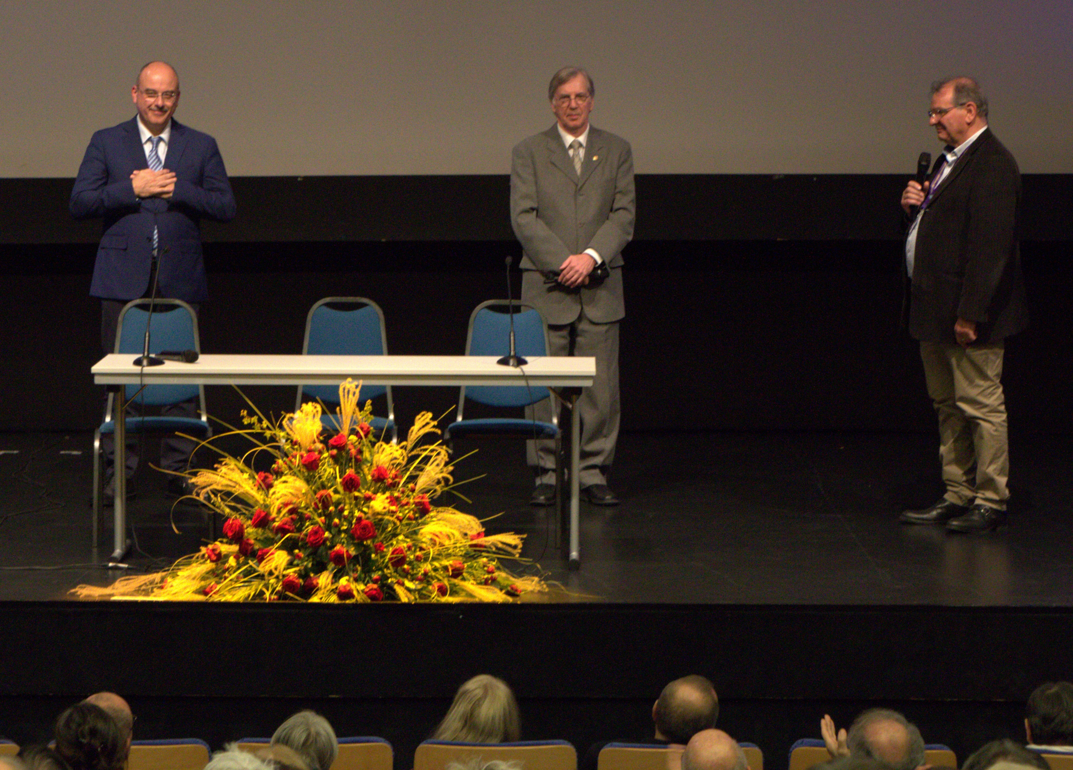
Liegi
November 2023

Slide 12
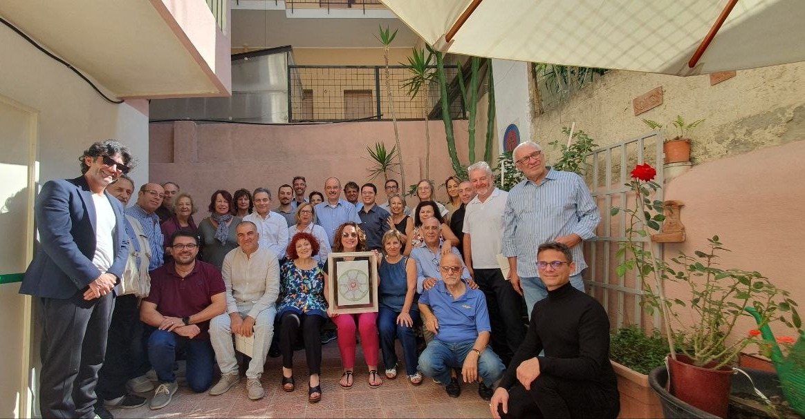
Italy – Amantea
November 2023

Slide 13
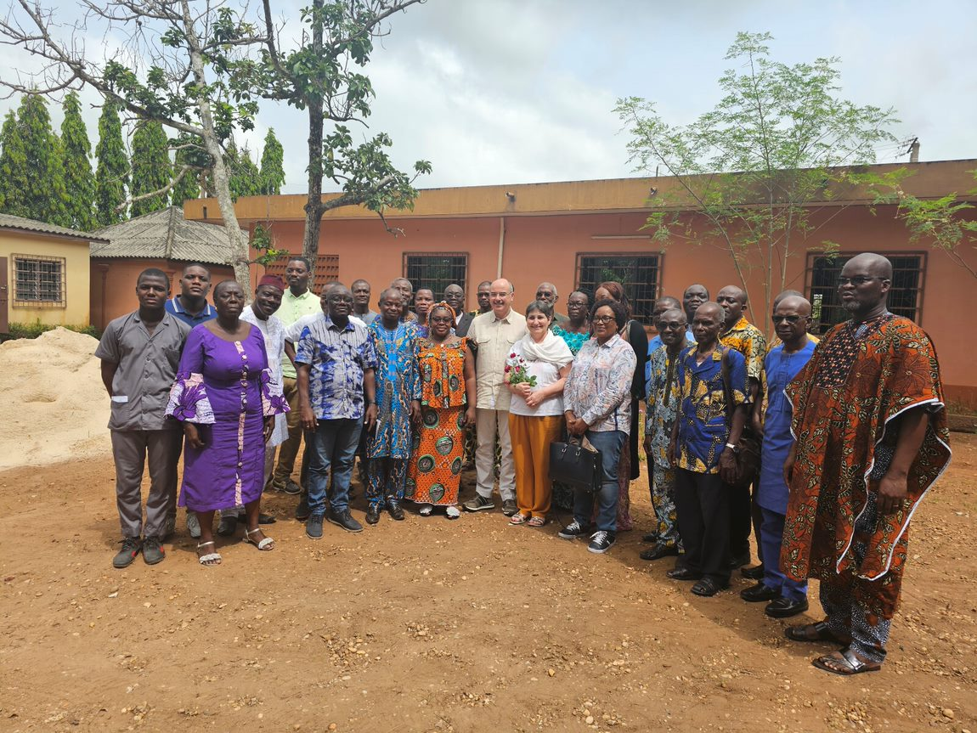
Benin
November 2023

Slide 14
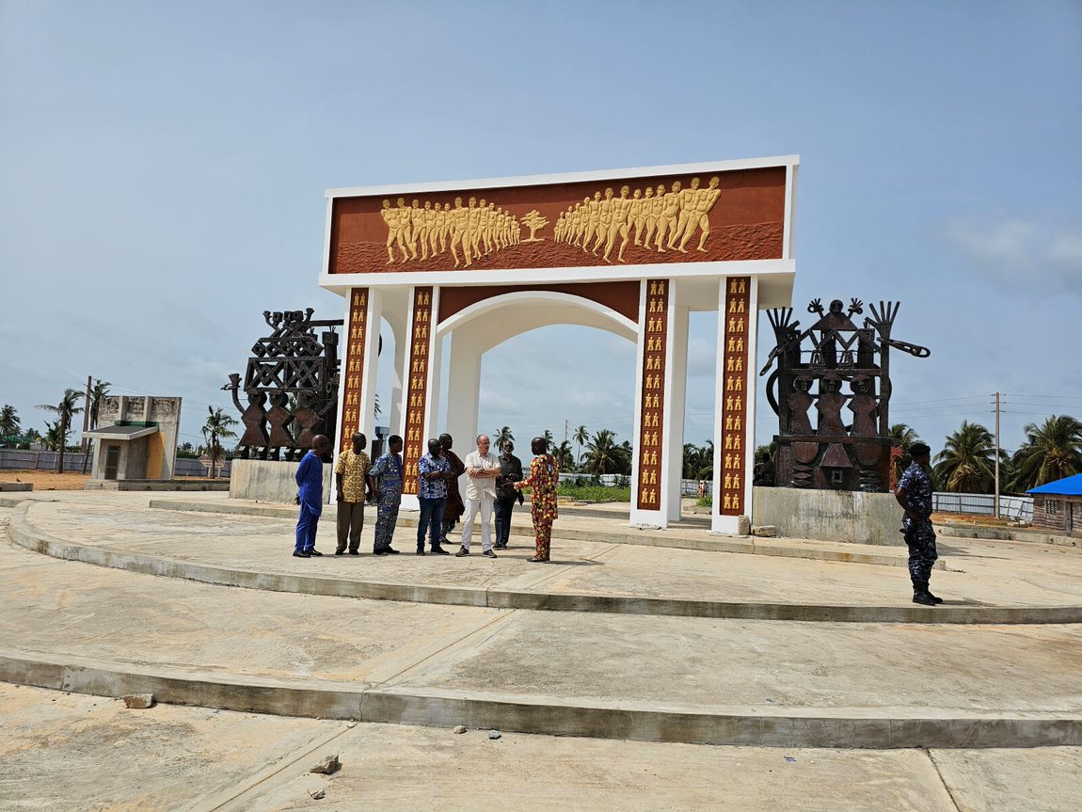
Benin – Door of No Return
November 2023

Slide 15
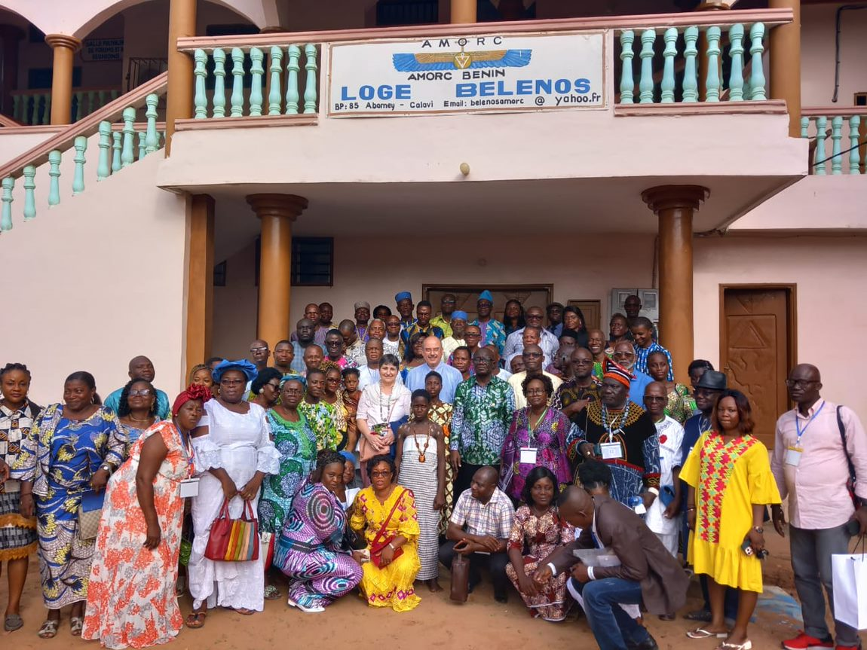

Slide 16
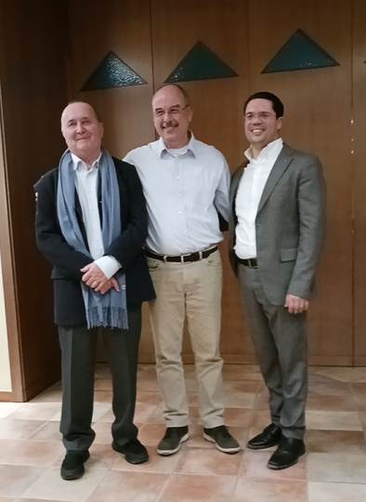
Italy Installation new Grand Master Frater Mirko Palomba December 2023
from left:
Jean-Philippe Deterville
Italian Grand Master - 1993-2008
Claudio Mazzucco
Italian Grand Master - 2009-2023
Mirko Palomba – new Grand Master

Slide 17
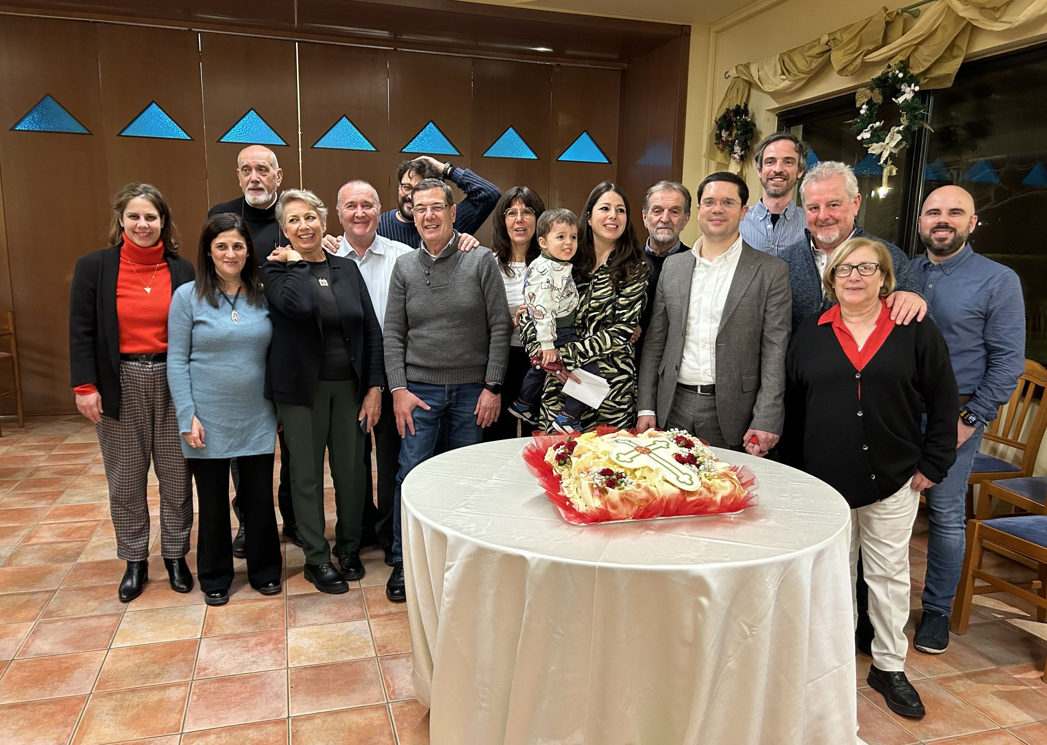
Italy
Installation new Grand Master
Frater Mirko Palomba
December 2023

Slide 18
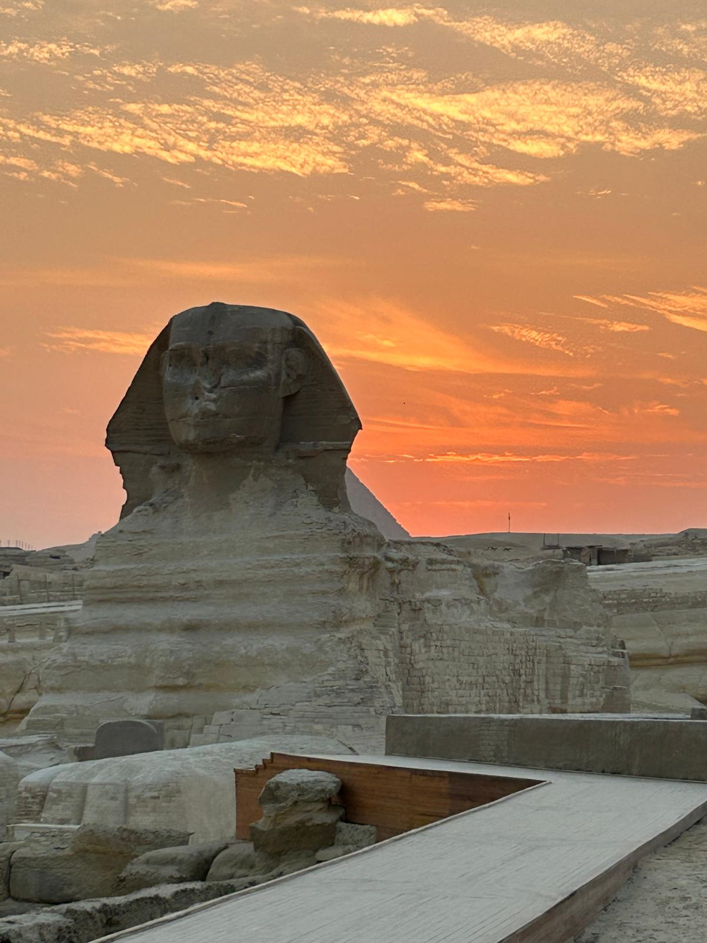
Mystical Journey in Egypt with members from Brazil, Congo and the Netherlands

